Slide 1
OPENCLAW LA • MAY 27, 2026
joe penclaw
my openclaw daily driver
bill kreutinger // km6slftech.com
self-hosted • docker • glm4.7 • tesla v100 • proxmox • obsidian • paperless-ngx

Slide 2
who is joe?
reads your notes
writes summaries
Obsidian vault — full read access to all markdown
One read-write folder for article summaries in Obsidian
knows your docs
builds live sites
Paperless-NGX archive — auto OCR'd & AI-tagged
Posts to Apache webroot via WhatsApp/Signal
powered by glm4.7 · self-hosted · always on

Slide 3
the hardware
HOST 1 — GMK K12 (proxmox)
HOST 2 — GPU WORKER
⟩ ubuntu vm · docker
⟩ zimaboard 2
open-webui · nextcloud
tesla v100 32gb vram
paperless-ngx · immich
ollama · glm4.7
home assistant · n8n
nomic-embed-text
LAN
openclaw · hermes-agent
granite3.2-vision
comfyui · qdrant
whisper stt
kokoro tts · signal-cli

Slide 4
how joe is wired up
obsidian notes
ro
apache webroot
rw
/vault (read-only)
live site creation (rw)
obsidian summaries
rw
remote blog
rw
/Interesting tech... (rw)
openclaw
joe penclaw
login creds — post on request
paperless-ngx
ro
signal / whatsapp
in
scanned docs archive (ro)
hermes (signal) + openclaw (wa)
tools via mcpo
nextcloud files
ro
comfy outputs
ro
joeuploads folder (ro)
ai image pipeline (ro)

Slide 5
the ai stack
LLM
glm4.7 via ollama on v100-worker
EMBEDDING
nomic-embed-text → qdrant vector store
VISION
granite3.2-vision (paperless-ai tagging)
STT
whisper on v100-worker:9001
TTS
kokoro-fastapi-gpu (af_heart voice)
IMAGE GEN
comfyui gpu-accelerated
RAG
hybrid search (dense + keyword) top_k=5
TOOL BRIDGE
mcpo (mcp → openapi) port 8006

Slide 6
DEMO
live website from whatsapp
1
bill takes a selfie and/or photo of the attendees
2
bill texts joe on whatsapp:
"Create a new file in your webroot directory called demo.html.
In that file create a website that includes the latest image file
in your whatsappfiles directory. The site should greet the
attendees of OpenClaw LA's 5/27 meeting. Use a dark theme
background with colorful accents."

Slide 7
DEMO
live website from whatsapp
3
joe writes html + css + js into /webroot
using mcpo tools — file access, image from whatsapp
4
cloudflare tunnel exposes site live
no port forwarding needed — secure tunnel already running
5
we open it in the browser — live!
scan the QR on the next slide
joe is building the site now // scan when the link appears

Slide 8

DEMO
scan when ready
QR CODE
add your link here

Slide 9
DEMO
article summary → obsidian
how it works
why it matters
› send joe a url or paste article text
› obsidian indexer embeds notes
› joe reads the full article
› → qdrant vector store
› summarizes key points, extracts links
› open-webui RAG searches them
› writes markdown note to the rw folder:
› joe can answer questions
› /Interesting tech Summaries...
› about your own notes
› note appears instantly in obsidian
› your knowledge base grows

Slide 10
DEMO
document q&a + blog post
paperless-ngx q&a
blog post on request
› documents auto-OCR'd on ingest
› remotely-hosted wordpress blog
› AI-tagged with granite3.2-vision
› joe has stored login credentials
› (model: ollama on v100)
› text joe via whatsapp: ‘Using your stored credentials for blog… write a post about X'
› Joe can search + quote your docs
› joe drafts + (if approved) publishes directly
› ask: 'what did my vet say...'
› ask: ‘what is Paula allergic to?'
› can include AI-generated images from comfyui, or images sent via WhatsApp

Slide 11
‘Bonus’ features
[CRON] scheduled check-ins
[NEW] bee computer integration
> joe (openclaw) → whatsapp
[ in development ]
> hermes-agent → signal
> bee computer records your day
> check in at configurable intervals – my personal ADHD assistant
> dev mode background service processes
bee transcripts, integrates key information into MEMORY.md
> keeps you on task
> reminds you of open tasks
> feeds joe's memory & knowledge
> morning briefings with weather
> of you and your context and tasks
> project status pings
"hey, you said you'd do X today"
> nothing to show yet — but coming!

Slide 12
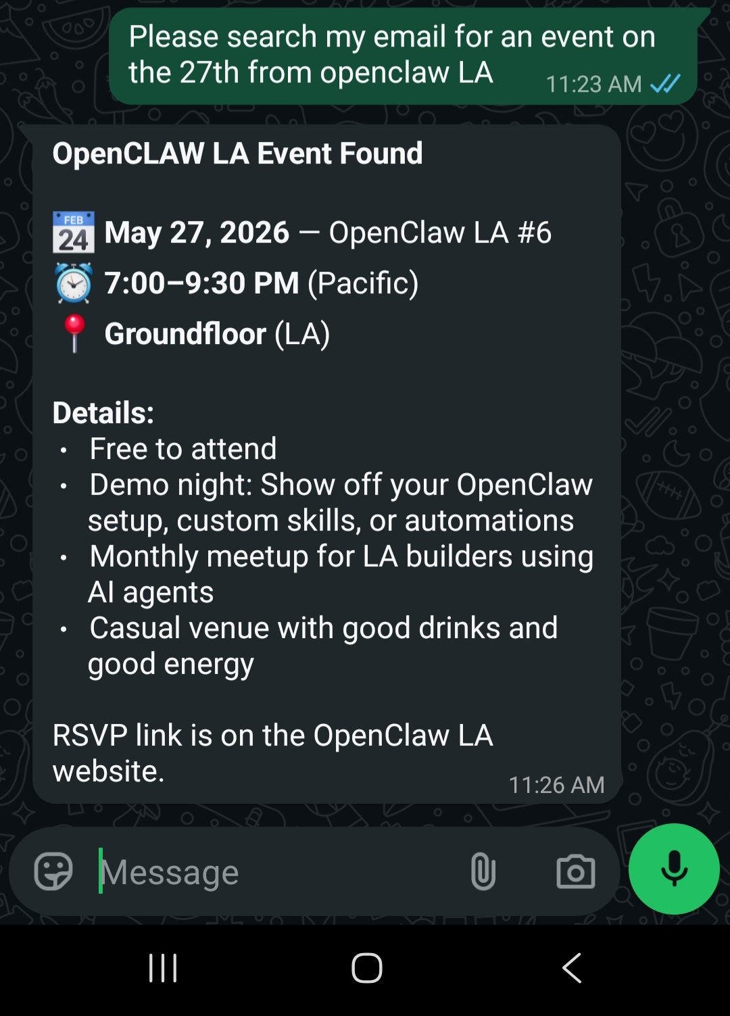
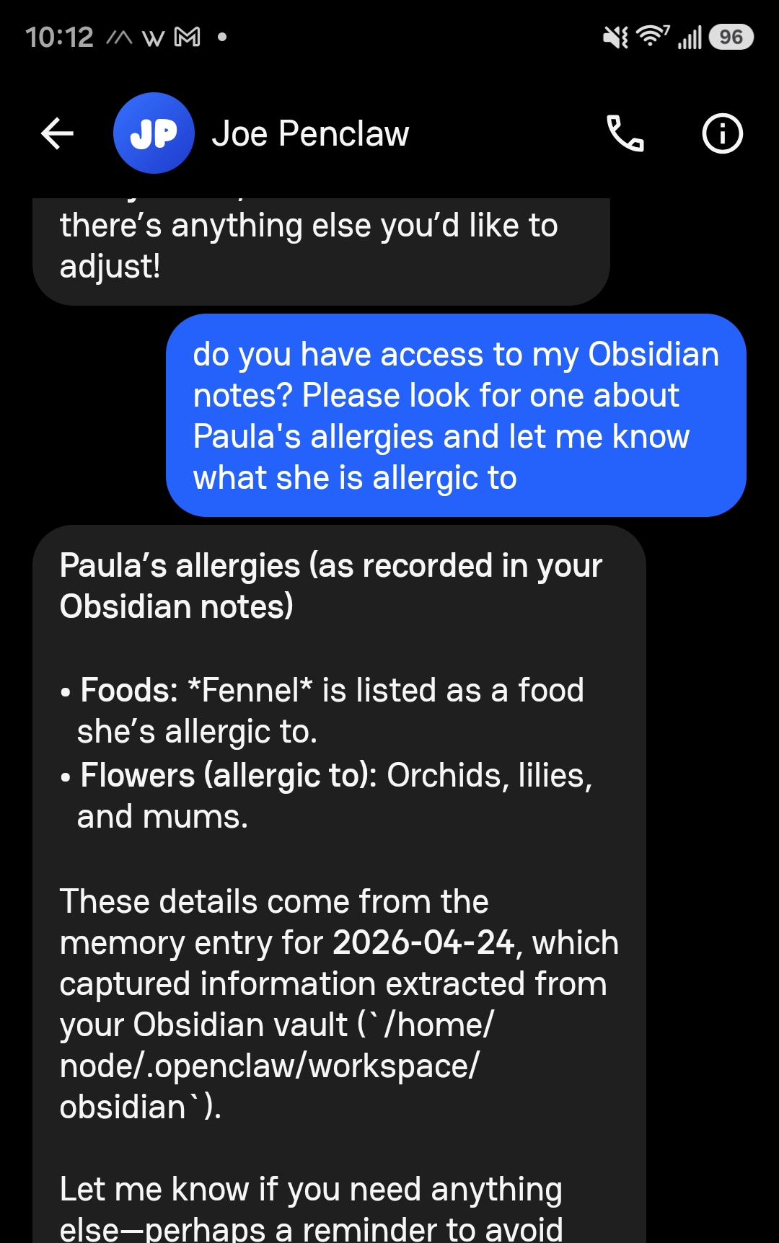
joe in action
// clip 1
// clip 2

Slide 13
get the files
docker-compose.yml (sanitized)
available tonight — credentials stripped, structure intact at gmk.km6slftech.com
openclaw + hermes-agent
agent layer
open-webui + qdrant
ai ui + vector db
paperless-ngx + tika
document mgmt
obsidian + indexer
notes + embeddings
nextcloud (full stack)
self-hosted cloud
signal-cli gateway
messaging bridge
cloudflare tunnel + ddns
external access
n8n + home assistant
automation
questions? // km6slftech.com // ham: km6slf // email: km6slf@gmail.com

